Slide 1
When Your Beneficiary Has A Mental Health Concern
What do you do?

Slide 2
What do you think of when you think of mental illness?

Slide 3





Slide 4





Slide 5
Question:
What are the types of mental health disorders, personality disorders, and stresses you notice in your beneficiaries which feel like a common occurrence? How did you discover those?

Slide 6
Challenges
Clients may be in denial, embarrassed, or uncomfortable.
Mental illness is seen by society as a moral failure instead of a disorder
Clients may not appreciate the important role their advisory team can play in crafting plans which help their loved ones facing mental health challenges.
Some trustees, even professional institutions, endeavor to avoid certain decision-making as to beneficiaries with challenges, whether it be an addiction, mental health, or other realities of the human condition.

Slide 7
What do hairdressers, manicurists, and trusted advisors have in common?
They all hear random, unexpected things from their clients that they’re expected to respond to but don’t know how to deal with.
But here’s the catch: if you want to be the trusted advisor that family members come back to through generations, you can’t just ignore or brush off these comments.

Slide 8
The Story of John
Yelling at the receptionist
Calling the trustee at random hours to talk without regard to time of day
No adherence to budget or agreements
Isolated
No motivation or desire to get a GED or job
Making demands and creating crises to get things done
Currently on trustee #5

Slide 9
Mental Health and Wealth Background

Slide 10
General Mental Health Stats
1 in 5 adults will experience mental illness in their lifetime
1 in 25 adults are diagnosed with serious mental illness, such as schizophrenia or bipolar disorder
1/2 of all chronic mental illness begins by age 14, and 3/4ths by age 24

Slide 11
Wealth and Mental Health
Ultra high net worth individuals are subject to becoming more at risk for developing higher rates of substance use disorders, depression, eating disorders, and anxiety
Children in affluent families suffer anxiety at 20-30% higher rates than the less affluent and are more likely to display anti-social behaviors such as cheating and stealing.

Slide 12
Potential Reasons
Suniya Luthar, a Professor at Columbia University, points to the pressure to achieve and isolation from parents as two potential causes for these outcomes.
Annette Lareau, a sociologist at the University of Pennsylvania, describes the parenting styles of the rich as “Concerted Cultivation.” The goal of this parenting style is “to accrue skills that will lead to greater opportunity later on.” Ultimately, the end result is that the wealthy children end up lacking practical skills and the parents run their children’s lives in a way that prolongs adolescence.

Slide 13
Potential Reasons Cont’d
Paul Piff and Dacher Keltner, psychologists at the University of California at Berkeley, conducted research which found that as people accumulate wealth and power, their empathetic feelings towards people begin to decline.
Other psychologists labeled the personalities of billionaires a “dark triad” of Machiavellianism, psychopathy, and narcissism. In studies of extremely wealthy people, results show greater tendencies towards engagement in various unethical behaviors as well as “self-promotion, emotional coldness, duplicity, and aggressiveness.” These traits undeniably influence parenting styles and decisions.

Slide 14
Wealthy Parents’ Dilemma
Saving their child from natural consequences = removing motivators for change/ learning but saves their kid from the immediate consequence and perhaps reputational damage
Using money to influence results instead of character or skill undermines a child’s ability to know their own value/ worth and creates doubt but gets them opportunities they may not have been able to get alone
Either promoting an air of “We are above the rules” or letting their kids learn in the school of “hard knocks”
It’s hard to appreciate or take ownership of things (like recovery or independence) where there is no buy in, consequence, or skin in the game
Either want to control their kid or be their friend and potentially used hired help to provide rules, guidance, and consequences

Slide 15
Wealthy Beneficiary Dilemma
No real need or purpose to pursue (too many choices, the paradox of choice)
Overcontrolled by spoken/ unspoken expectations
Guilt over opportunities provided to them or entitlement
Influence of money and family name over identity (who am I outside of the wealth and who likes me outside of the wealth)
Is the goal of treatment help for me or getting me to conform to my parents desires for me?
Parents can pay for institutions until change is made even when it isn’t working

Slide 16
Goals
1. Proactive ways to discover and work with people who have mental health issues
2. Productive ways to work with people who have mental health issues when you step on the landmine…

Slide 17
Goal 1
Proactive ways to discover and work with people who have mental health issues

Slide 18
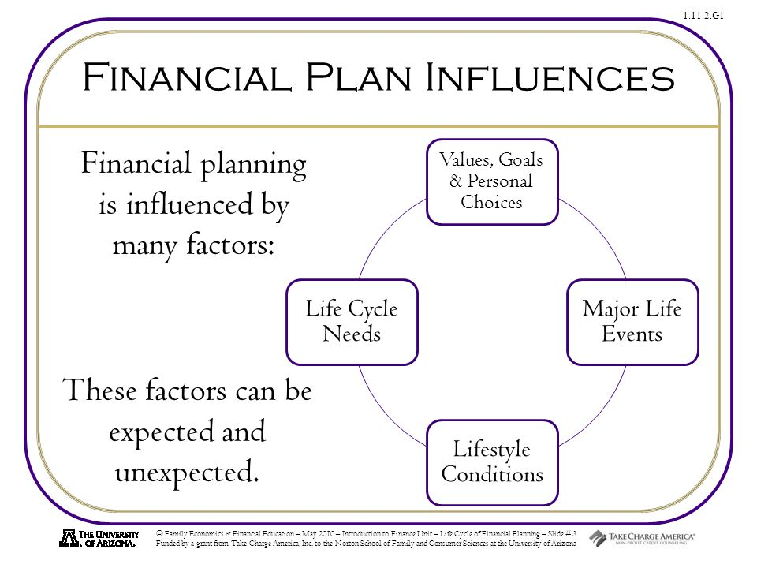
There is a bi-directional relationship between financial planning and major life events. Knowing this helps you prepare and plan. Planning and preparing involves the financial component as well as addressing the human component

Slide 19
How do you start the conversation?
Make it a part of your initial onboarding process
Be direct in preparing them for your line of questioning and why it’s important
Get agreement along the way by asking “is that okay with you?”
Tell current clients who are beyond the onboarding process that you went to this presentation and recognize the importance of improving your practice in this way
When something comes up, use these questions and agreements as something to refer back to down the road

Slide 20
Here’s what it looks like
Hi (name),
At (name of firm), we really understand how mental and physical health impact the planning process. Going over this intake form in detail is a part of our onboarding process for every client and I’ll be asking a lot of follow-up questions along those lines so that we can make sure your present and future are properly planned for. I understand these are incredibly personal questions, and if at any point you need me to explain the relevance, I’m happy to do so. Is that ok with you?

Slide 21
Discovery Questions
Is there anyone in your family who isn’t prepared to handle the wealth they’re about to inherit?
Tell me about the relationships and personalities in your family?
What are your/ your child’s worst and best qualities?
Are there any concerns about physical or mental health that you have for yourself or any of your family members ?
(if a client mentions they have a mental health issue) Will you tell me about how that’s impacted you so I can help plan for that?
Are there any ongoing and consistent needs we need to budget for right now?

Slide 22
Policies and Procedures
Policies and procedures can become a default fall guy to save your relationship…even if you’re the one who created and can change the policies and procedures
Create policies and procedures which slow things down to a reasonable pace
Ex: All requests for additional money must be in writing and there is a 3- business day delay before an answer is given

Slide 23
Resources to have readily available
Case Manager
Interventionist
Independent Consultant
Criminal defense attorney familiar with mental health cases
Mental Health Counselor
Private investigator

Slide 24
Review every couple of years
Policies and procedures, plus the outcome of those when they met real life situations
Resources available
Mental and physical health status of the beneficiary

Slide 25
Goal 2:
Productive ways to work with people who have mental health issues when you step on the landmine…

Slide 26
Why Beneficiaries Destabilize
First psychotic break or bout of symptoms
Relapse in addiction
Decided to stop taking medications
Stress and hormone shifts changed the effectiveness of meds
Traumatic events
Onset of mental illness
This can take you off guard and make you unsure how to relate to the person or what to do next.

Slide 27
Things you might notice
Changes in communication style and consistency
Random requests for money or liquidation of assets
Abrupt changes in estate plan
Illogical thinking
Noticeable, frequent or incongruent mood changes
Poor money management
Higher medical bills
The client tells you directly
A family member tells you directly

Slide 28
Things you might notice if a family member has a MH issue
Client has urgent need to liquidate assets
Adult children who still live with their parents and are not acting in a caregiver capacity
A family member begins showing up to meetings with the client and helping to guide decision making to their own benefit
Money or assets being funneled away from the client
You become aware of legal issues related to the client’s behavior
The client wants to alter the estate to exclude one family member

Slide 29
How Do You Respond?

Slide 30
How not to respond
Avoid things which put people on the defensive
Avoid coming across as defensive
Avoid escalating your tone, volume, and body language
Avoid shutting down the conversation with blanket statements (ex: that’s just the way it is and you’re going to have to accept that)
Avoid making promises you can’t keep

Slide 31
How to respond
Stay non-judgmental
Understand your limits, their limits, and what their needs are that they’re trying to get met in that moment
Validate and restate their needs and perspective
State facts and observations

Slide 32
How to respond cont’d
Ask relevant questions: Are you ok? Do you need help?
Help them play the tape forward on their options
Get clear on your goal, state your goal, ask client what their goal is and see if it aligns
Create a mutual agreement to move forward

Slide 33
How to respond cont’d
Know the relevant resources available to help
Take action
Follow-up

Slide 34
Calling 911: How To Respond When Issues Are Identified
What you do: | What you don’t do:
Identify there is a problem | Diagnose the problem
Ask relevant questions: Are you ok? Do you need help? | Fix it yourself
Know the relevant resources available to help | Ignore it
Take action | Walk away before appropriate resources are in place
Follow-up | Play the hero

Slide 35
Be Part of the Solution: 3 Effective Ways of Partnering with Clients With MH Issues
Normalize
Normalize the discussion. Remember addiction and mental illness is quite common, even among wealth, successful and highly educated clients.
Ask
Ask direct questions to the client about the issues.
Provide
Provide support by offering reassurance, resources, and respect.

Slide 36
Questions to move you forward
Good questions will help you get in alignment, lower defensiveness, and find a path forward.

Slide 37
This could look like:
I know how stressful it is for you every time you overspend and need to come to me for more money. I want to help you navigate this situation and prevent this from happening again in the future by being able to address the reasons you keep overspending. Are you willing to work with someone on this issue so that you don’t end up in this position again?
(State the parameters) are the parameters I can work within. I want to create a way for you to win in this situation without me jeopardizing my job. What does winning look like for you within the parameters I have to work within?
I’ve noticed in the past month that you’ve sent me emails which feel urgent, aren’t remembering conversations, and avoid getting on the phone with me. These changes seem abrupt and unlike you. I’m concerned and wanted to open the door to have a conversation. What do you think changed for you in the last month?

Slide 38
Key Phrases for Trustees
“I heard you list 3 things that you really wanted right now. Help me understand what feels most important to you right now so I can work on that.”
“It seems like this situation feels really heavy. Will you help me understand more?”
“Would it be unreasonable if we looked at some options together that wouldn’t jeopardize the trust?”
“Given the confines of my role and needing to clear this with the trust committee, what would a good outcome look like for you here?”
“Here’s what I can do, and here’s where the trust limits me. If we use the money for this, that might mean there’s no option to take money out of the trust for the next 6 months. Would that feel worth it to you?”

Slide 39
Things To Remember:
The situation, feelings, level of importance, and intensity feel very real for the beneficiary
Crises and humor don’t typically mix
Questions to move you forward

Slide 40
Q&A

Slide 41
Contact Info:
Name: Amanda Koplin
Company: Koplin Consulting
Website: Koplinconsulting.com
Email: amanda@koplinconsulting.com

